Slide 1






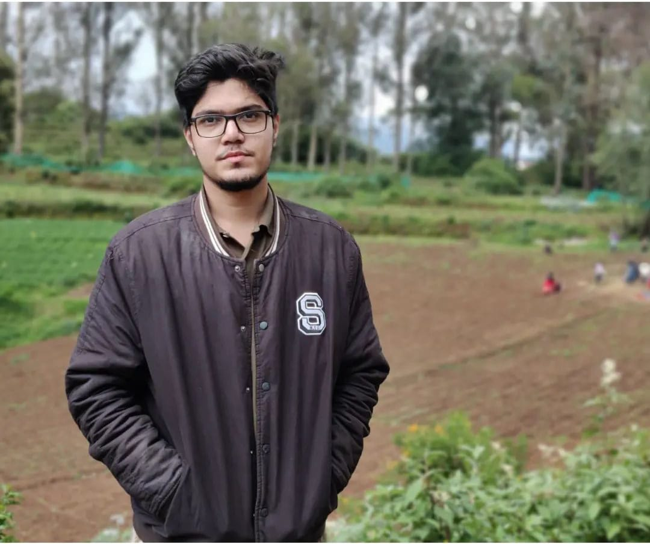



BARBIE
Team Members
Rachel
Alisha
Krithi
Melissa
Syona
Deepak
Nanda
Tony
Rithesh

Slide 2
Indian Agriculture Analysis
Indian Agriculture Analysis

Slide 3


INTRODUCTION
This project is a comprehensive analysis of Indian agriculture, undertaken collaboratively by our team.
The significance lies in providing detailed insights for both the government and market stakeholders.
All data has been collected from scratch, ensuring originality and accuracy.

Slide 4

Project Objectives
Brief overview of the importance of agriculture in India
Analyzing trends, diversity, and factors influencing agricultural decisions
Creating an easy, user-friendly interface
Data Overview
The dataset utilized in this analysis serves as a comprehensive repository of agricultural information crucial for understanding farming trends and decision-making processes. It consists of 500 meticulously curated records, each representing distinct facets of agricultural practices in India.

Slide 5

Column Names
Crop Name (Categorical): Refers To The Name Of The Crop Being Cultivated.
Type Of Agricultural (Categorical): Indicates The Type Of Agricultural Practice Employed.
Technique Used (Categorical): Specifies The Techniques Utilized In Crop Cultivation.
Varieties (Numerical): Represents The Number Of Crop Varieties Cultivated.
Average Temperature (Numerical): Provides The Average Temperature Conditions During Cultivation.
Average Precipitation (Numerical): Indicates The Average Precipitation Levels During Cultivation.
Highest Producer (Categorical): Identifies The Highest-producing Region For The Crop.
Soil Type (Categorical): Describes The Type Of Soil Prevalent In The Cultivation Area.
Average Market Price (Numerical): Represents The Average Market Price Of The Crop.
Average Seasonal Price (Numerical): Indicates The Average Seasonal Price Variation Of The Crop.
Fertilizers (Categorical): Specifies The Fertilizers Used In Crop Cultivation.
Irrigation (Categorical): Describes The Irrigation Methods Employed.

Slide 6
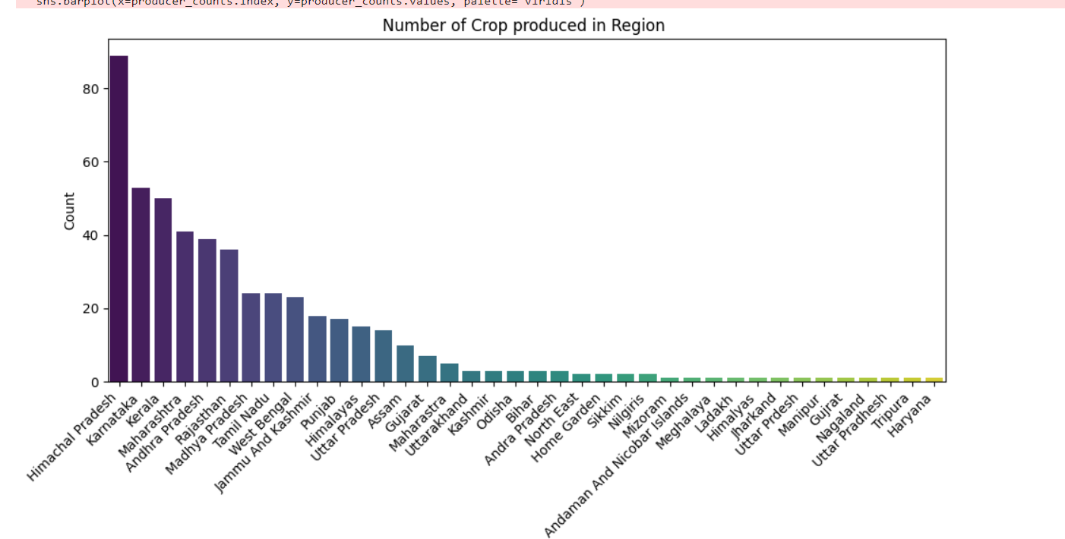
Exploratory Data Analysis
Himachal Pradesh leads with close to 80 crop productions.
Karnataka, West Bengal, and Andhra Pradesh also show significant crop production.
Gujarat, Punjab, and Tamil Nadu contribute moderately to crop production.
Regions like Meghalaya and Tripura exhibit minimal crop production

Slide 7
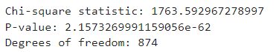
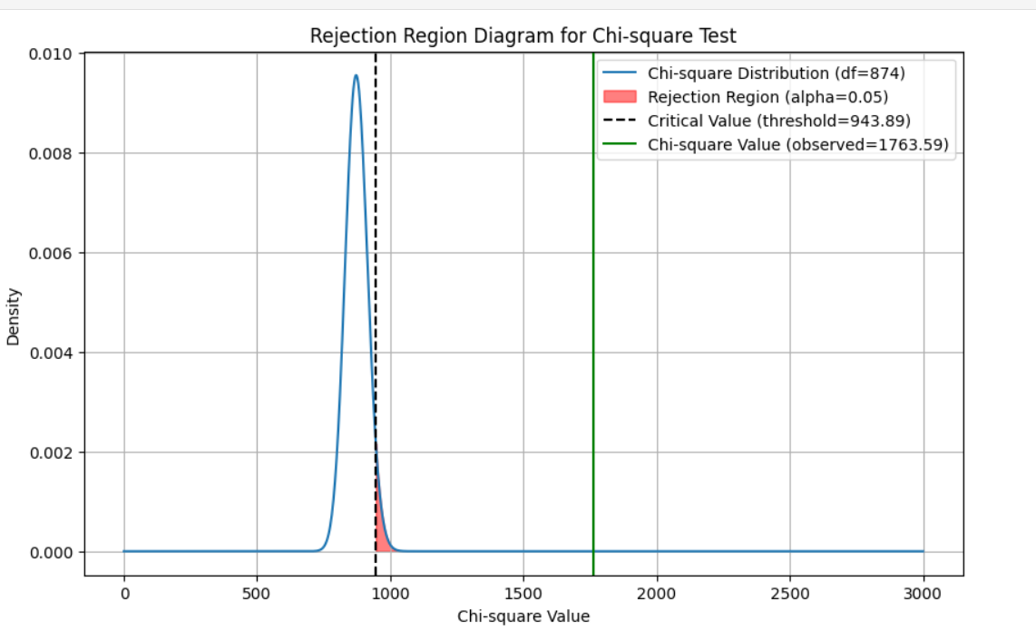
Chi Square Test For Soil Type And Irrigation
The chi-square statistic measures the strength of association between 'Soiltype' and 'Irrigation'. A higher chi-square value (1763.59 in this case) indicates a stronger association.
The extremely small p-value (2.157e-62) indicates that it's highly unlikely to observe such an extreme result by chance. We reject the null hypothesis of no association and conclude that there is a significant association between 'Soiltype' and 'Irrigation'.
With 874 degrees of freedom, the test accounts for the number of independent observations, reflecting the complexity of the relationship between 'Soiltype' and 'Irrigation'.

Slide 8
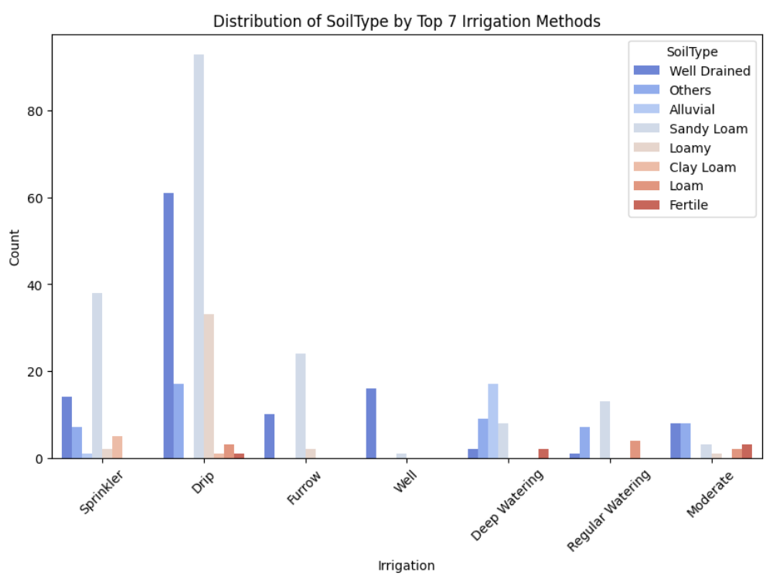
Distribution Of Soil Type By Top 7 Irrigation Method
Well Drained : Predominantly associated with sprinkler and drip irrigation methods.
Others : Represents soil types not explicitly categorized.
Alluvial : Notable count linked with the Deep Watering irrigation method.
Sandy Loam : Distributed across various methods.(Sprinkler , drip , furrow)
Loamy ,Clay Loam ,Loam : Present in varying proportions across methods.
Fertile : Associated with specific irrigation methods

Slide 9
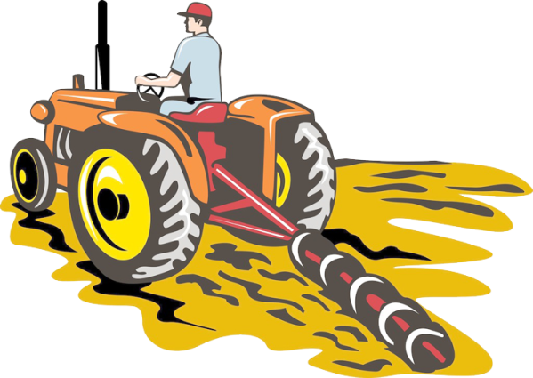
What is KMeans Clustering
KMeans clustering is a data analysis technique used to identify natural groupings (clusters) within a dataset. It segments data points into clusters based on similarity, making it easier to understand complex datasets.
Why KMeans Clustering is Vital for Agricultural Business Analysis
Crop Segmentation: Clustering helps categorize crops based on similarities in characteristics such as varieties, environmental factors, and market prices.
Business Strategy: It enables businesses to tailor their agricultural strategies by understanding which crops share common traits and market dynamics.
Market Insights: By clustering crops, businesses gain insights into market trends, allowing for targeted marketing and pricing strategies.

Slide 10

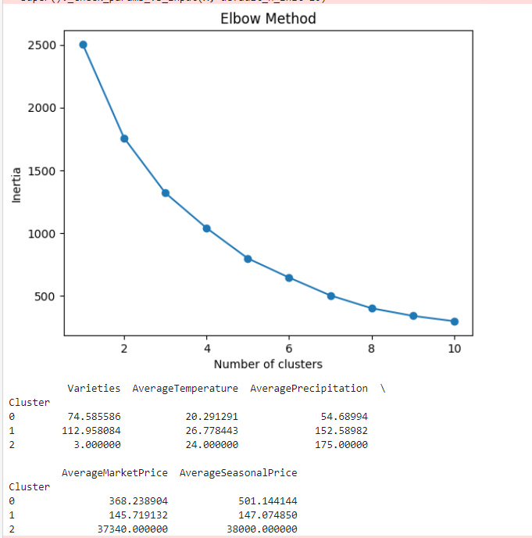
KMEANS-CLUSTERING
Cluster 0: Moderate varieties and environmental conditions, with corresponding moderate market and seasonal prices.
Cluster 1: High varieties and favorable conditions, but lower market and seasonal prices.
Cluster 2: Low varieties, yet high precipitation levels result in exceptionally high market and seasonal prices.

Slide 11

What is MANOVA
MANOVA stands for Multivariate Analysis of Variance.
It's a statistical technique used to analyze the simultaneous response of multiple dependent variables to one or more independent variables.
Why MANOVA for This Project
Multiple Variables: We're studying various factors like fertilizers, soil types, temperature, and precipitation.
Interrelated Variables: These factors may influence environmental conditions simultaneously.
Comprehensive Insights: MANOVA helps us understand how these factors collectively affect environmental conditions, providing a holistic view.

Slide 12
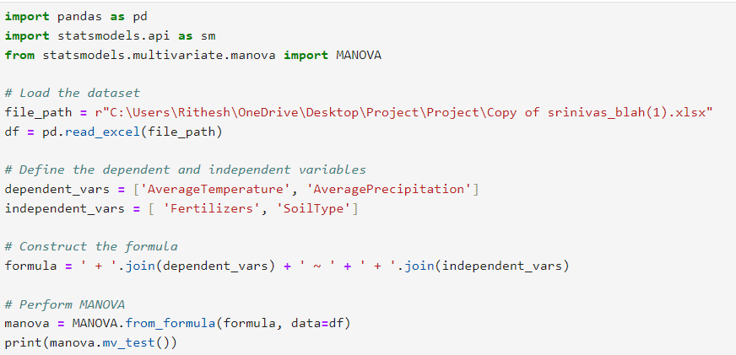
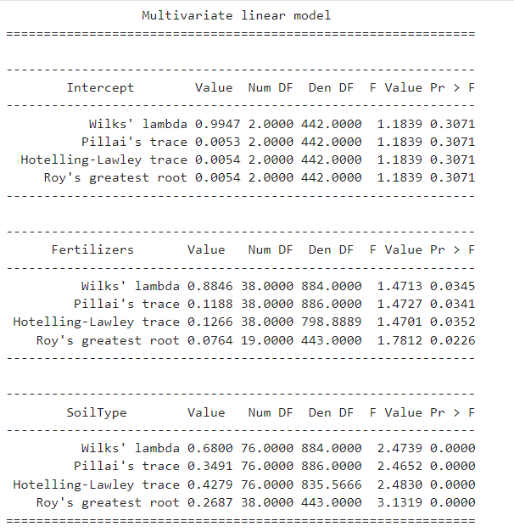

Multivariate Analysis Of Variance (MANOVA)
INPUT:
The code conducts a Multivariate Analysis of Variance (MANOVA)
To explore how different agricultural practices (fertilizers and soil types) relate to environmental conditions (temperature and precipitation).
It checks whether there are significant differences in these conditions across various agricultural methods.
OUTPUT:
Overall: No significant overall effect observed (p > 0.05).
Fertilizers: Significant effect observed (p < 0.05).
SoilType: Highly significant effect observed (p < 0.05).

Slide 13
Crop Information User Interface
Ease of Use: Designed intuitively for seamless navigation, ensuring users can effortlessly access the information they need.
Input Functionality: By simply entering the crop name, users can unlock a wealth of data about cultivation techniques, varieties, climate preferences, market prices, and more.
Comprehensive Data: The interface offers a thorough overview of each crop, empowering users with in-depth insights crucial for decision-making, from selecting suitable crops based on climate to understanding market trends.
Decision Support: Armed with comprehensive crop information, users gain the knowledge needed to make informed decisions, whether it's farmers optimizing crop choices or policymakers crafting agricultural strategies.

Slide 14
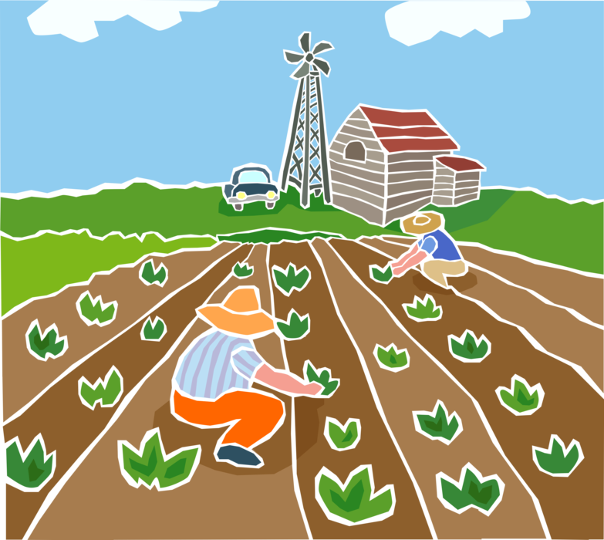
Audience Engagement and Real-Time Updates
Target Audience:
The interface caters to a diverse range of users, including:
Individual farmers seeking guidance on crop cultivation practices.
Government officials involved in agricultural policy-making and resource allocation.
Market stakeholders interested in understanding the characteristics and marketability of different crops.
Real-Time Updates:
The interface is designed to accommodate updates and additions to crop information as new data becomes available, ensuring its ongoing relevance and usefulness.

Slide 15
Suitable Crops For Growing User Interface
Input Parameters: Users provide local climate data (temperature, precipitation) and soil type information.
Analysis: The interface employs algorithms to analyze these parameters against a database of crop requirements and environmental tolerances.
Crop Recommendations: Based on the analysis, the interface suggests suitable crops for cultivation in the user's area.
Decision Support: This helps users make informed decisions, optimizing agricultural productivity and resilience to environmental variability.
Accessibility: The interface is designed to be user-friendly, accommodating users with varying levels of technological proficiency.
Continuous Improvement: Feedback mechanisms allow for ongoing refinement, ensuring the recommendations remain accurate and relevant over time.

Slide 16

Future Directions
Data Enrichment: Continuously integrate new data sources to enrich the dataset.
Advanced Analytics: Explore more sophisticated techniques for deeper insights.
Geospatial Analysis: Incorporate mapping and spatial analysis for regional insights.
Enhanced User Interfaces: Improve usability and functionality based on user feedback.
Integration with IoT: Explore connecting with IoT devices for real-time data.
Partnerships: Collaborate with stakeholders for resources and expertise.
Scalability and Accessibility: Ensure the platform can grow and reach more users.
Community Engagement: Foster collaboration and knowledge-sharing within the agricultural community.

Slide 17

Website Link
http://192.168.37.111:5000/
Conclusion
In conclusion, the Indian Agricultural Analysis project has successfully dissected the complexities of India's agricultural landscape. By meticulously analyzing data and developing intuitive interfaces, the project has provided stakeholders with actionable insights to enhance decision-making processes. From aiding farmers in crop selection to assisting policymakers in crafting effective agricultural strategies, the project's impact spans across various sectors. Moving forward, the project's dedication to continuous improvement ensures its pivotal role in driving positive change and innovation within India's agriculture industry.

Slide 18
THANK YOU

